Slide 1
Presentation Topic :
Drill-down: Interactive Retrieval of Complex Scenes using Natural Language Queries
Submitted by,
Name: Rafid Mostafa ID: 16101069
CSE431:Natural Language Processing

Slide 2
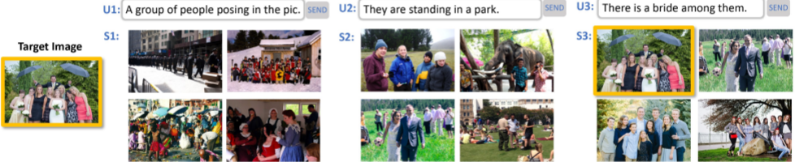
Introduction
Problem statement:
>The task of interactive image retrieval using natural language queries
Audience:
>Implementation can be helpful for any kind of audience.

Slide 3
Earlier /Posterior works
Methods:
1. Multiple query attributes;
2. Multiple query retrieval system ;
3.Dialogue based image search systems ;
4.Memory networks;

Slide 4
Contributions
> Introducing “Drill-down”, an interactive image search approach;
>Presenting a large-scale natural image dataset: Visual Genome ;
>Outperforms competing baseline methods;

Slide 5
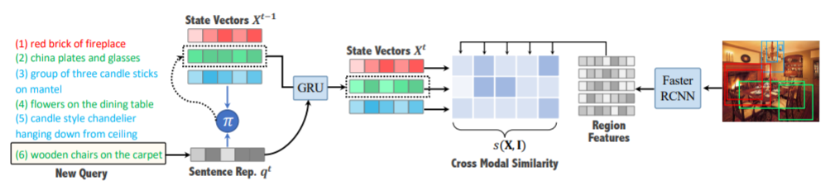
Preliminaries
1. Image representation ;
2. Query representation ;
3. Cross modal similarity ;
4. Query encoding ;

Slide 6
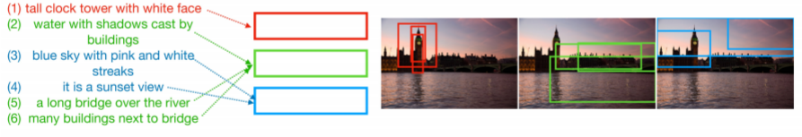
Results
Identification accuracy ;
Outperforming other baseline methods;
Random user satisfaction ;

Slide 7
CONCLUSION
Restatement:
>Drill-down, a framework that is efficient and effective in interactive retrieval of specific images of complex scenes.
Opinion:
Is it really better ?
Is it all successful?
Is it helpful to the community?

Slide 8
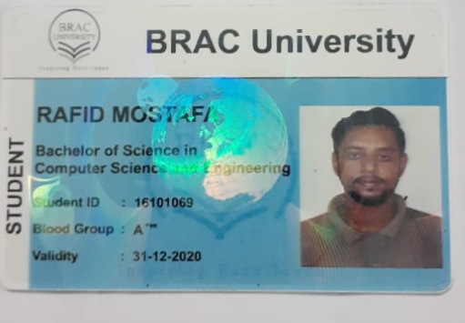
Any questions ?
Here is my credentials .Thank you.

